Slide 1
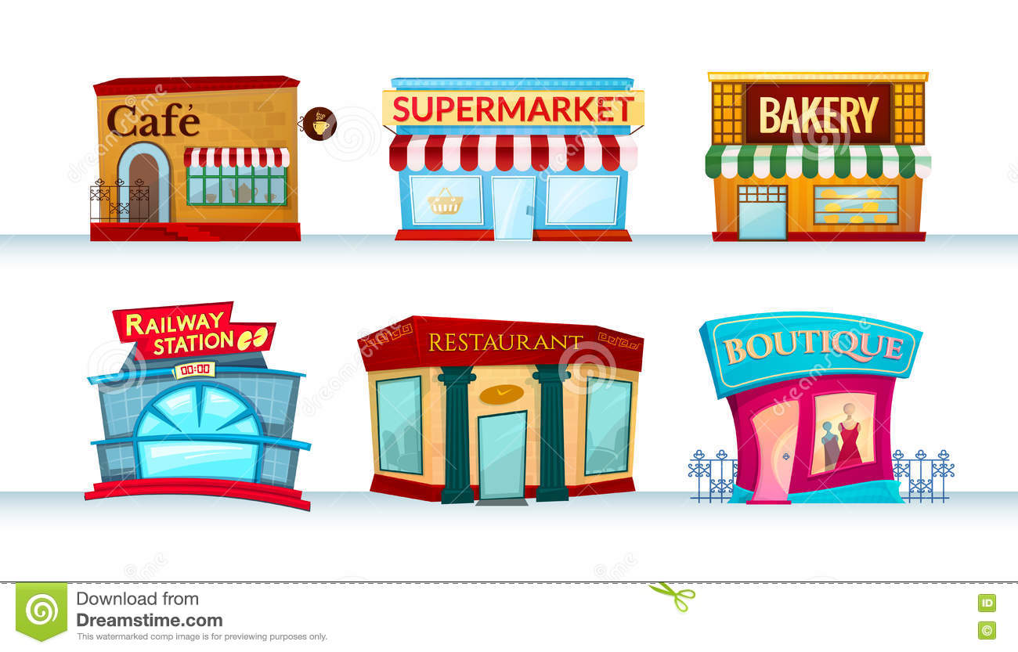
Were you at the supermarket yesterday?

Slide 2
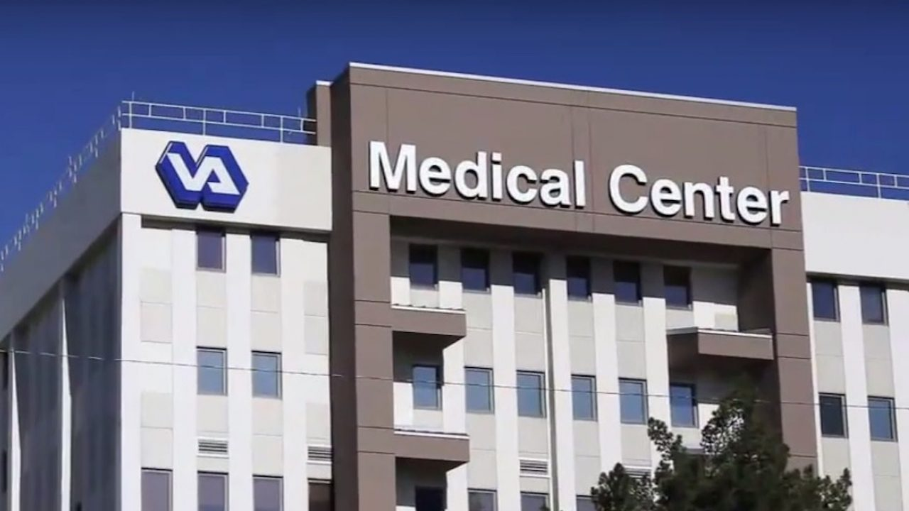
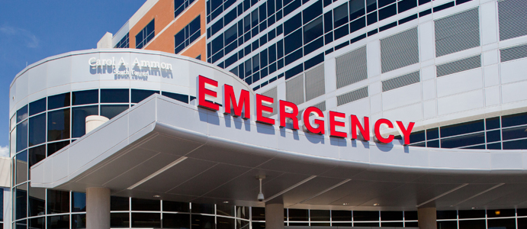
hos∙pi∙tal
hospital

Slide 3
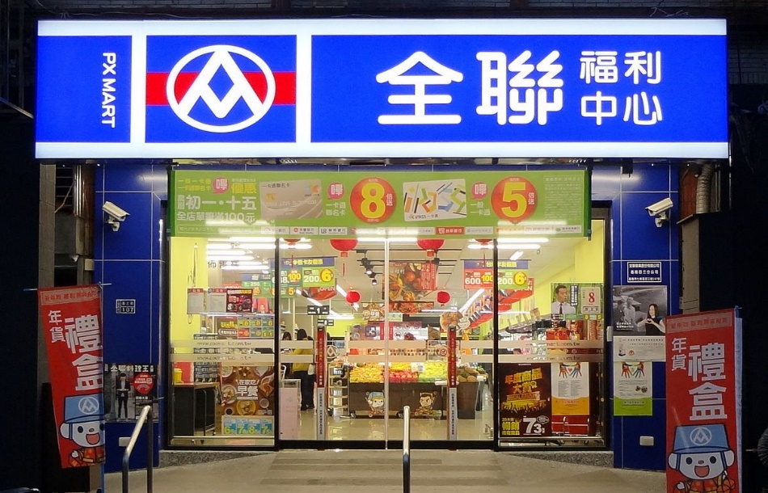
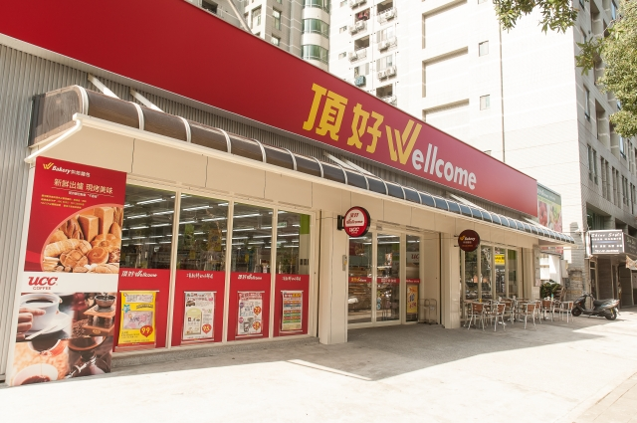
su∙per∙mar∙ket
supermarket

Slide 4
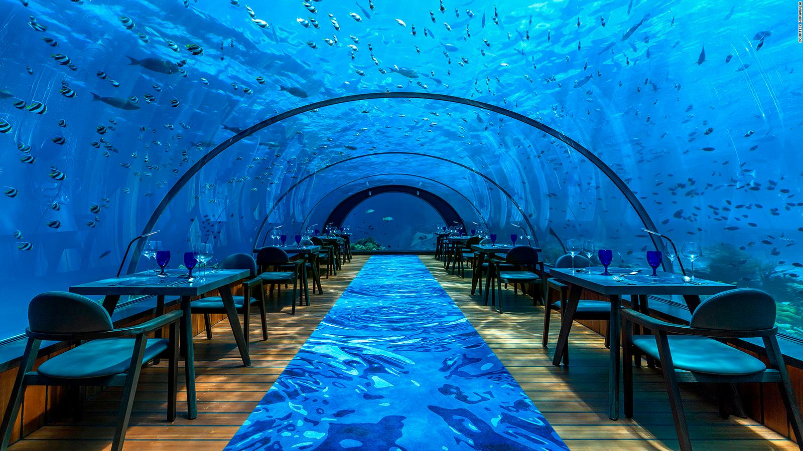
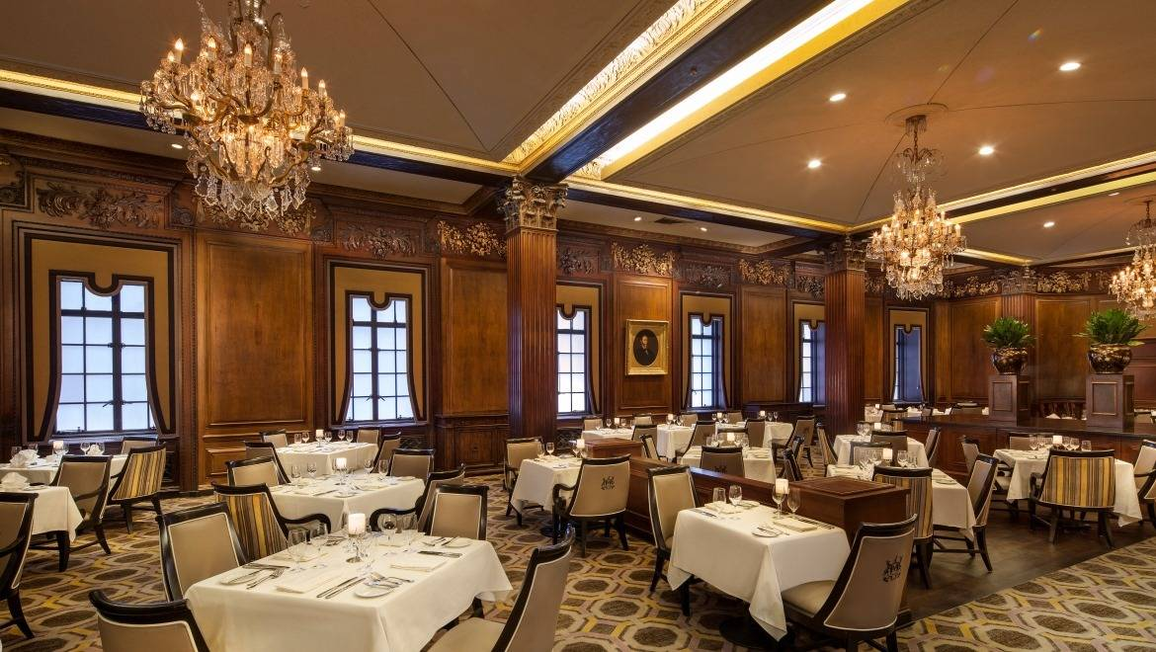
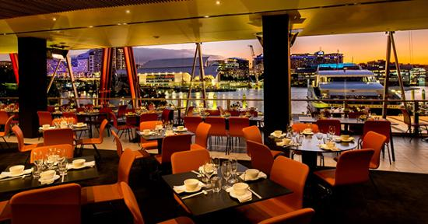
res∙tau∙rant
restaurant

Slide 5
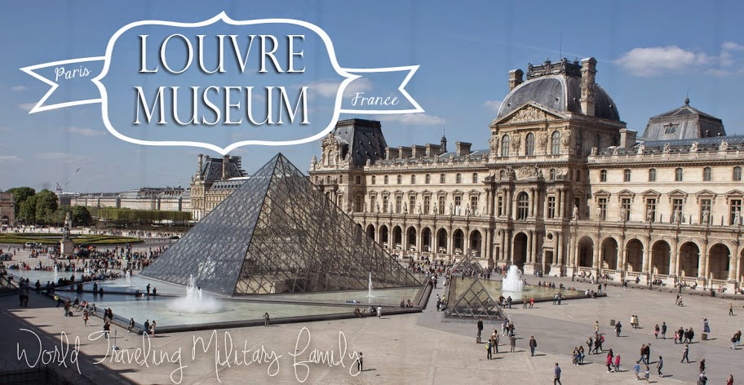
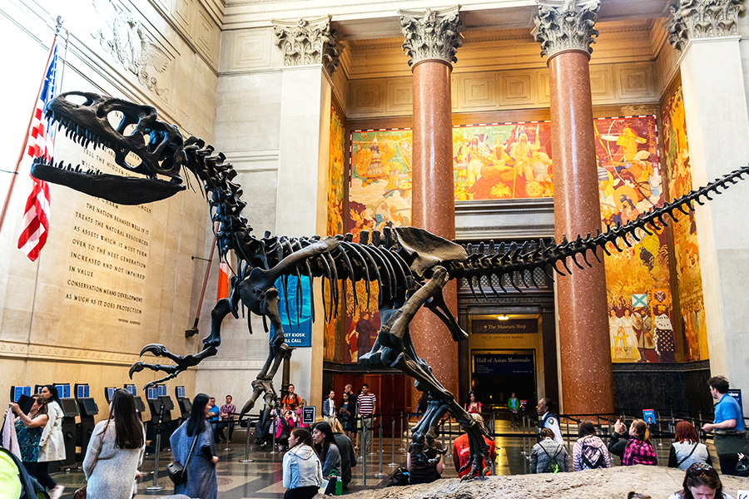
mu∙se∙um
museum
American Museum of Natural History

Slide 6
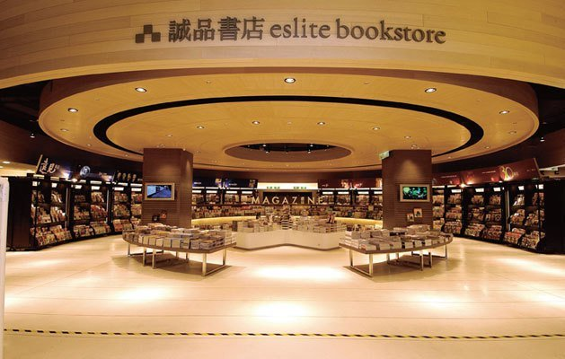
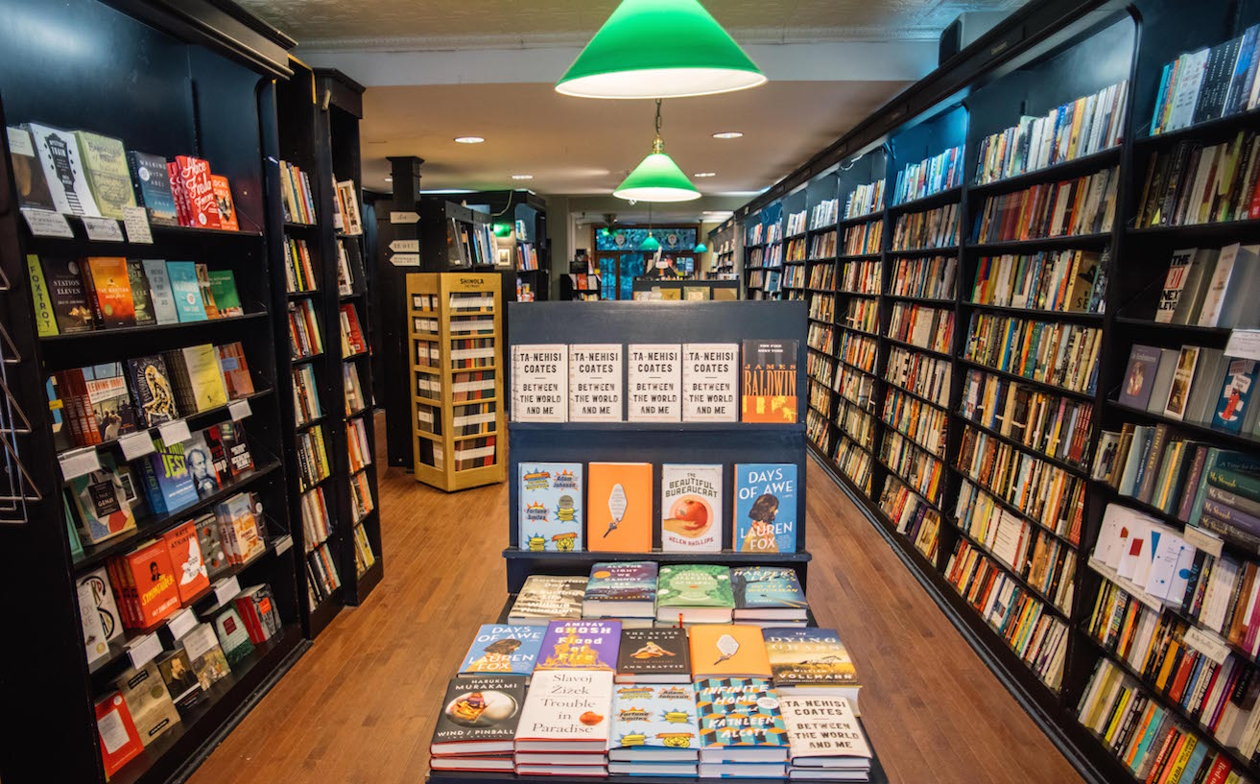
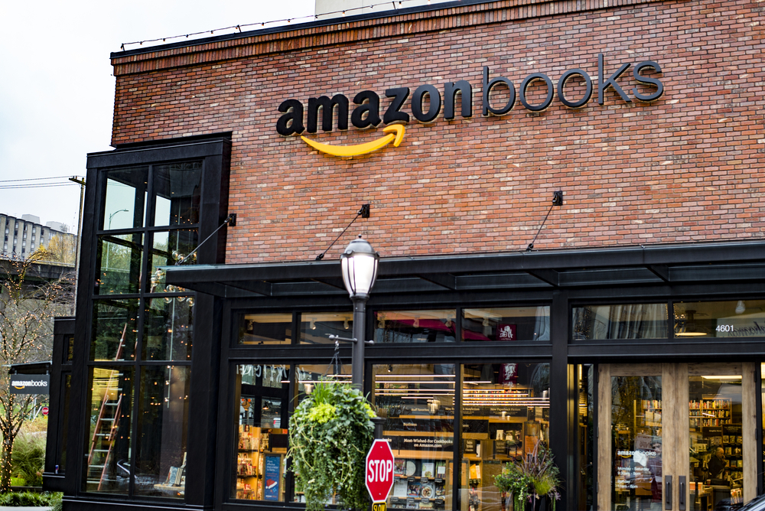
book∙store
bookstore

Slide 7
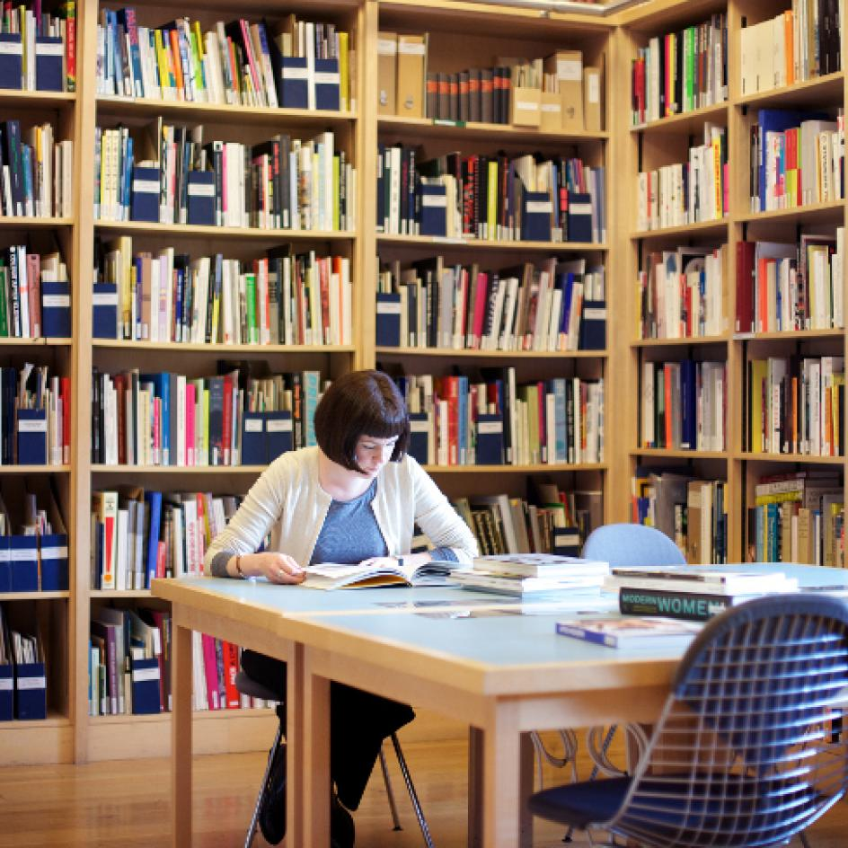
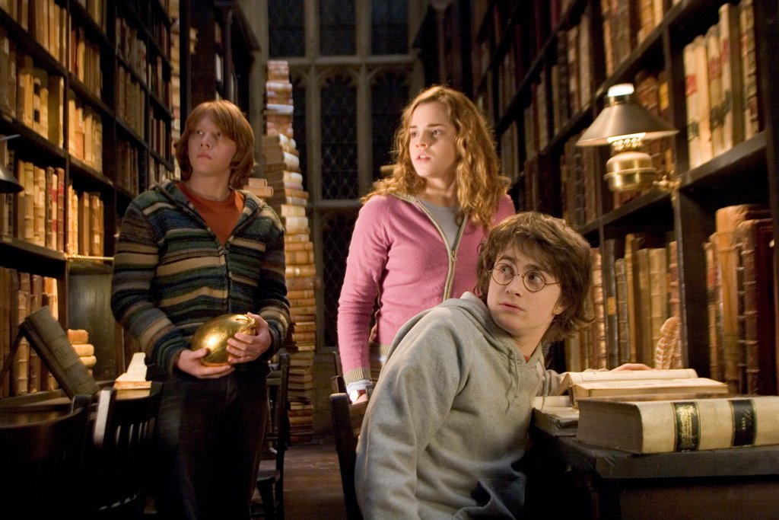
li ∙ bra ∙ ry
library

Slide 8
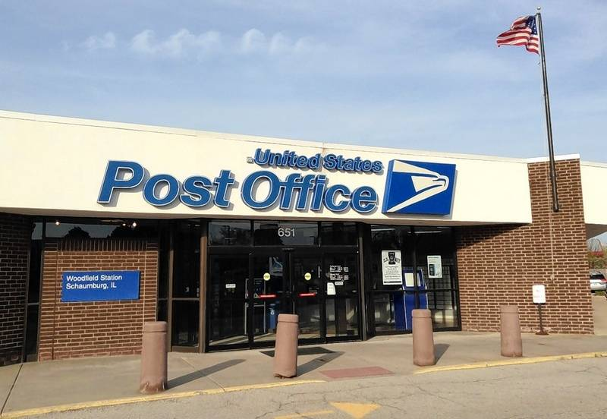
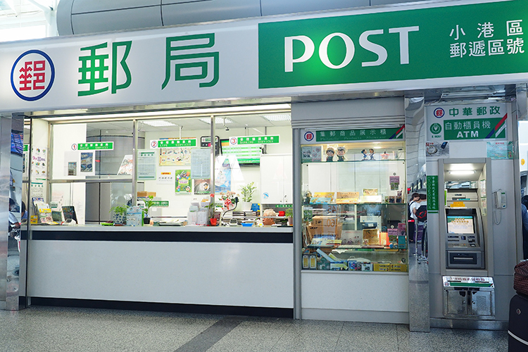
post office
post office

Slide 9
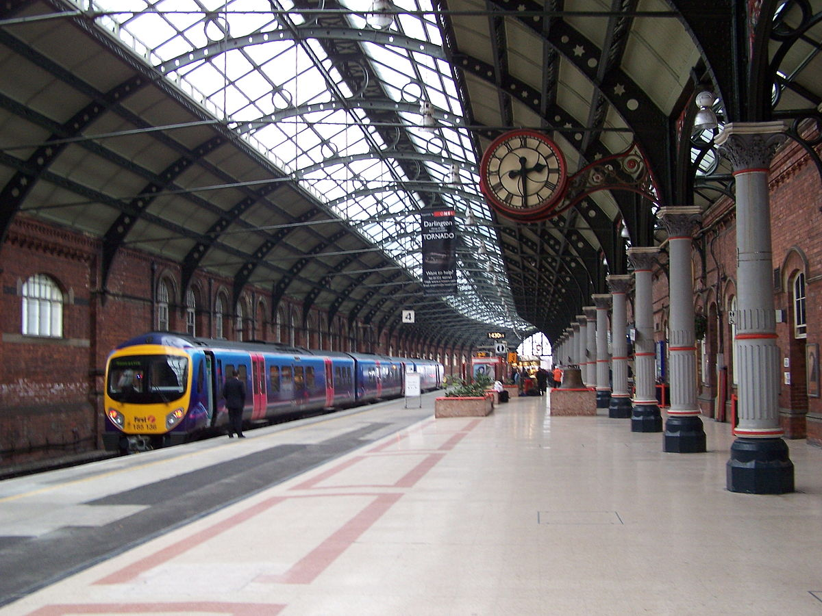
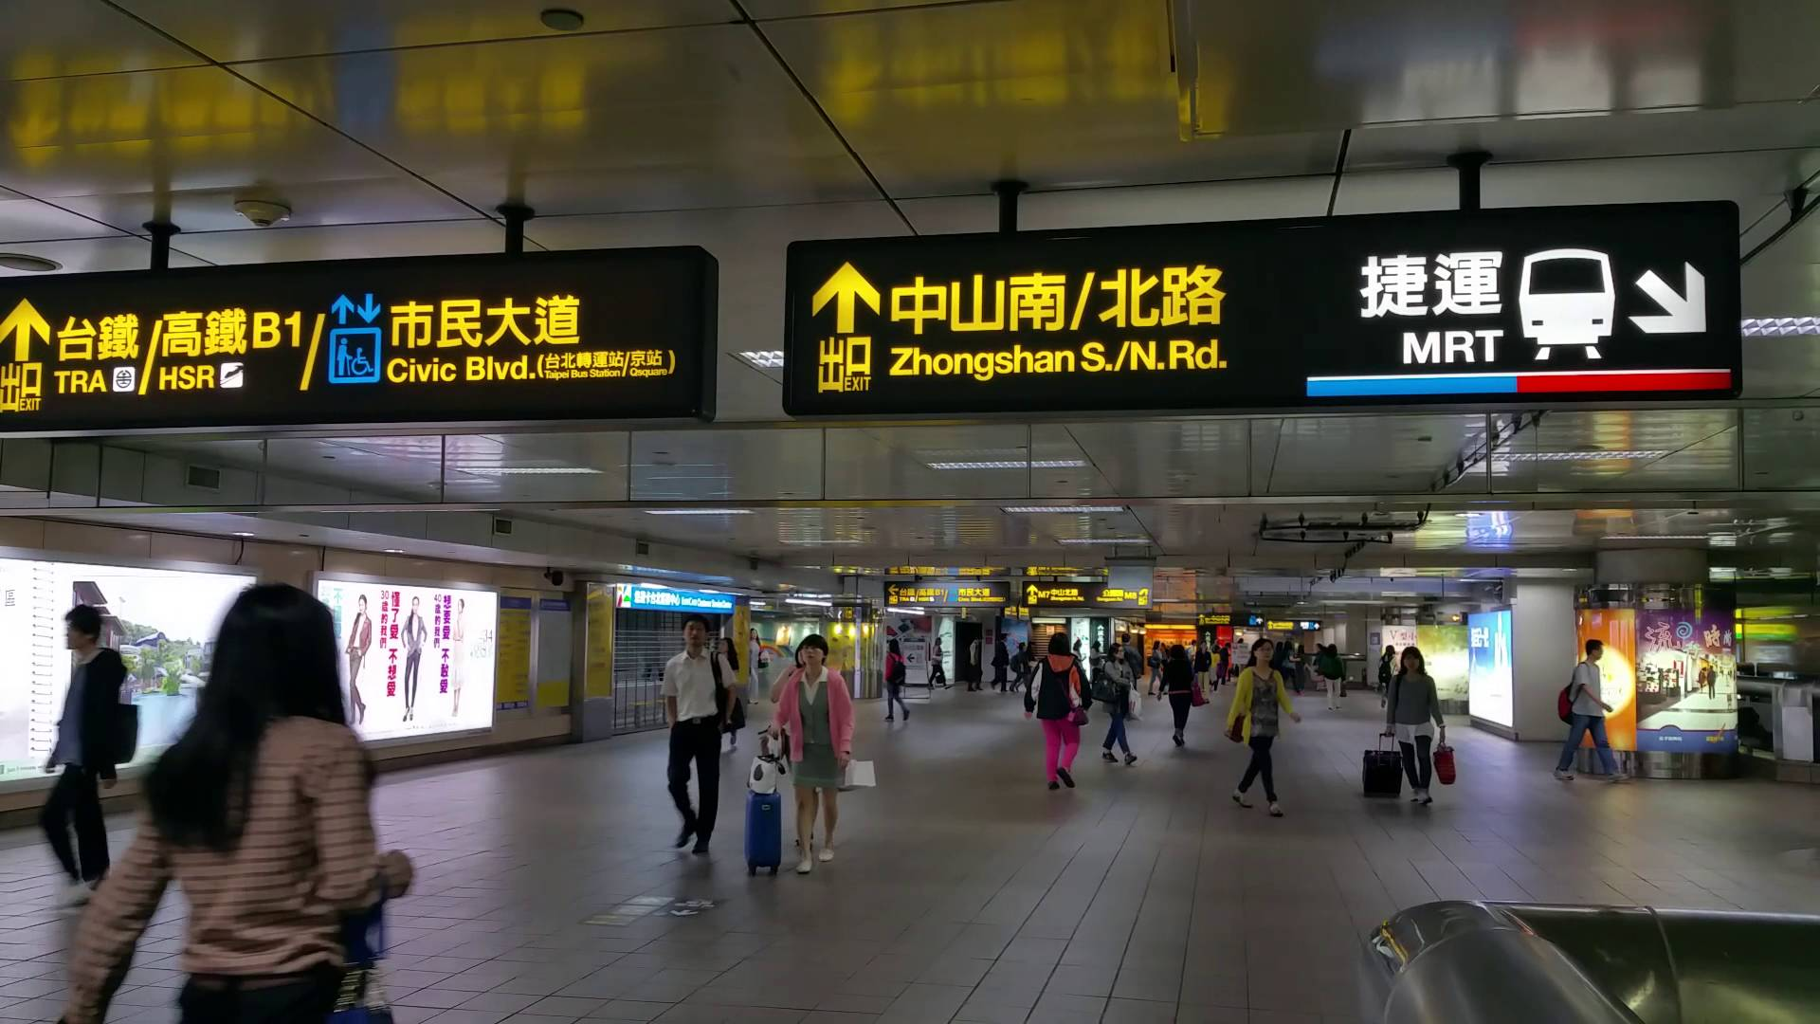
train station
train station

Slide 10
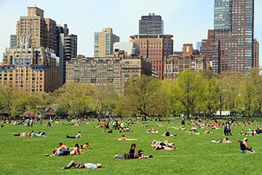
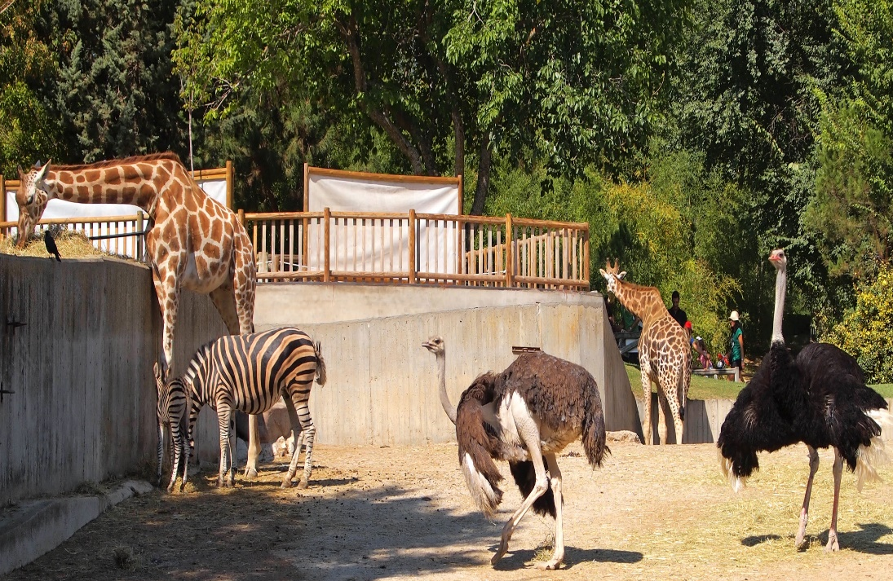
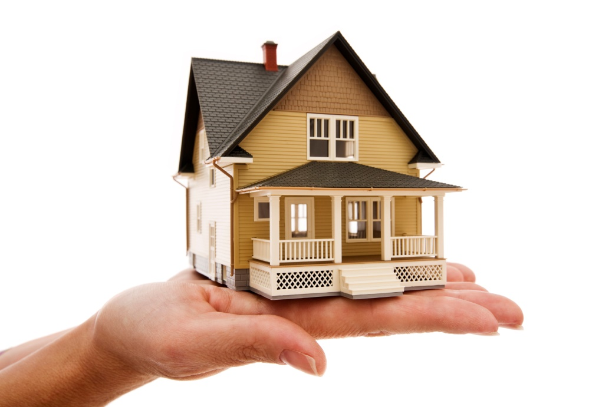
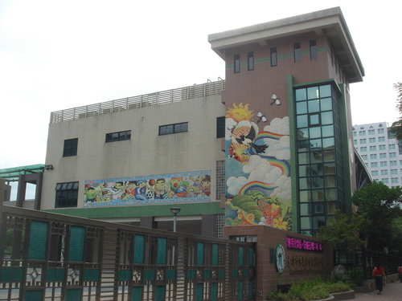
Review the words you learned before.
zoo
park
home
school

Slide 11
at+小地方
定冠詞
指定某個地點
at the……
at home/school

Slide 12
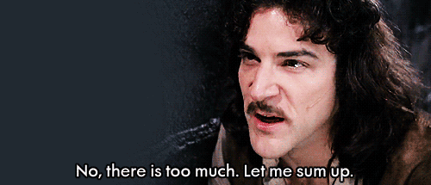
I 、He、She → was / wasn’t
We 、You、They → were / weren’t

Slide 13
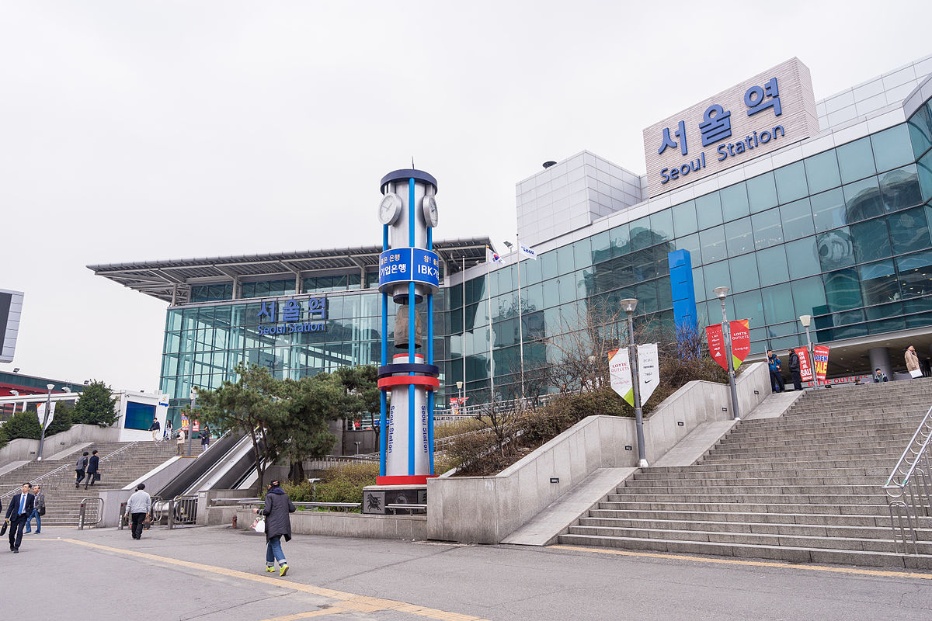
Q1: Was Tzu-Yu at the park yesterday?

Slide 14
No, she wasn’t. She was at the train station yesterday.

Slide 15
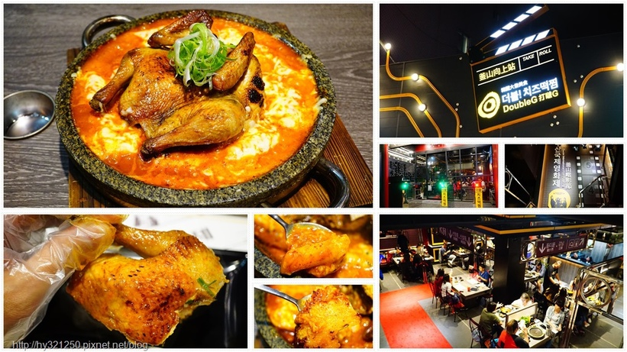
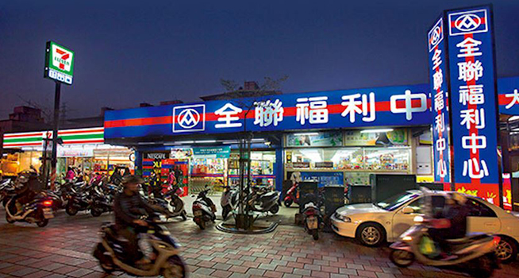
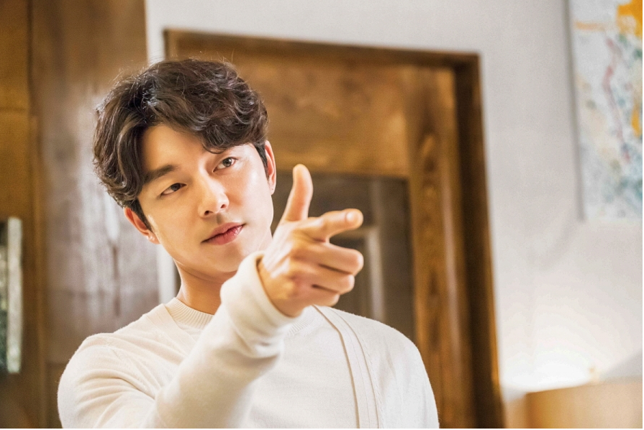
Q2: Was Gong Yoo at the restaurant yesterday?

Slide 16
Yes, he was. He was at the restaurant yesterday.

Slide 17
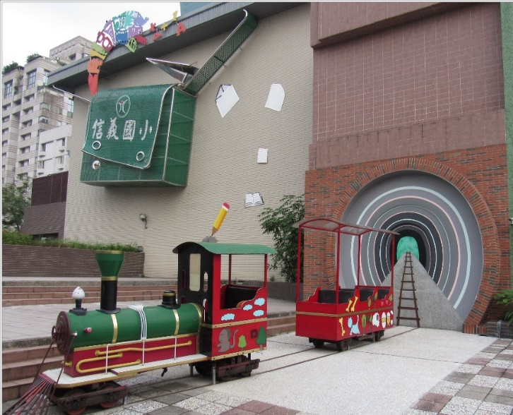
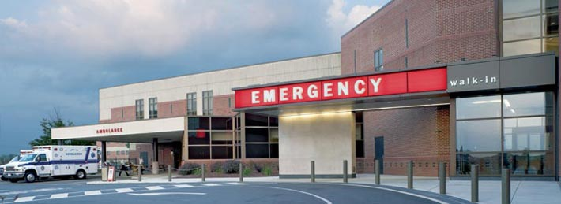
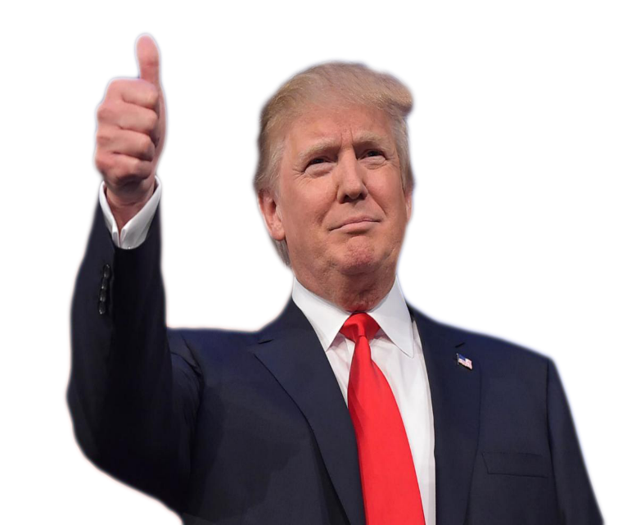
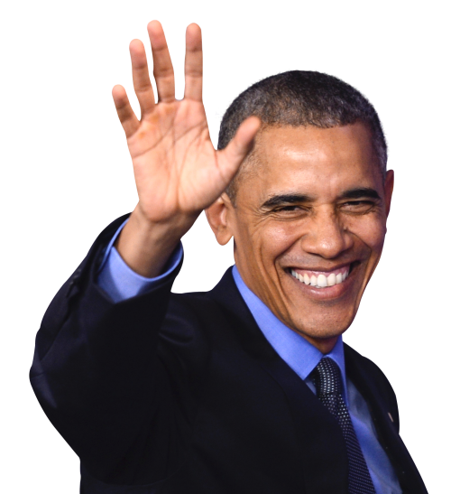
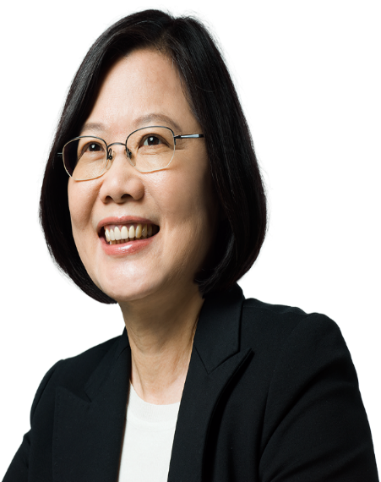
Q3: Were President Trump and President Tsai at the bookstore yesterday?

Slide 18
No, they weren’t. They were at the hospital yesterday.

Slide 19
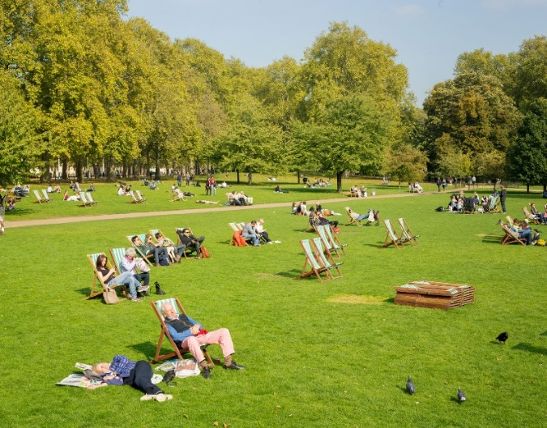
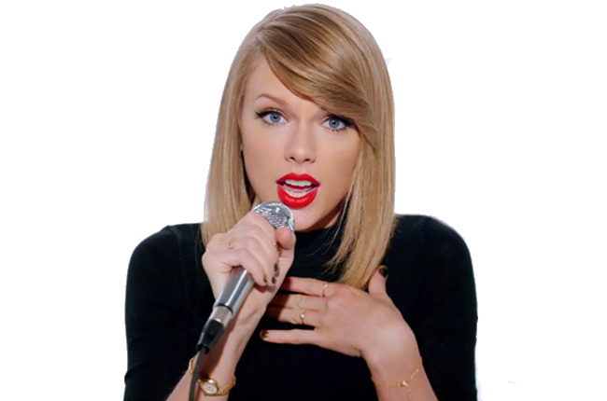
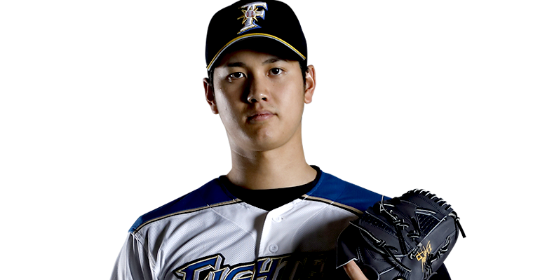
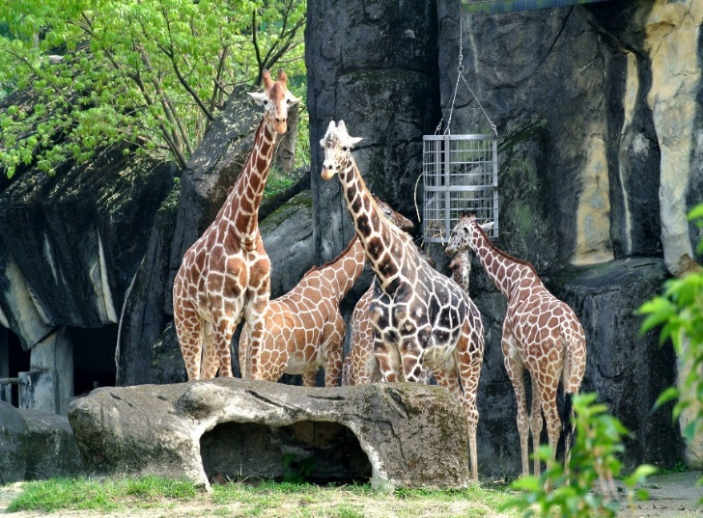
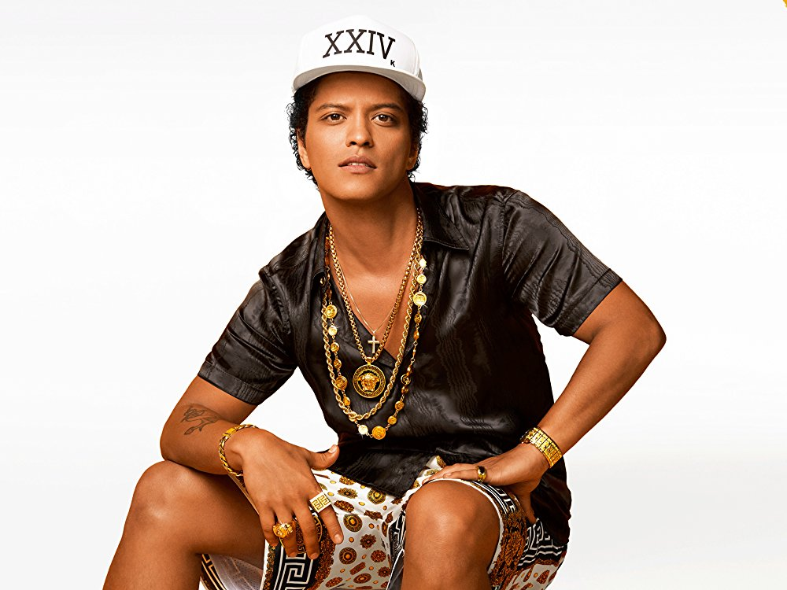
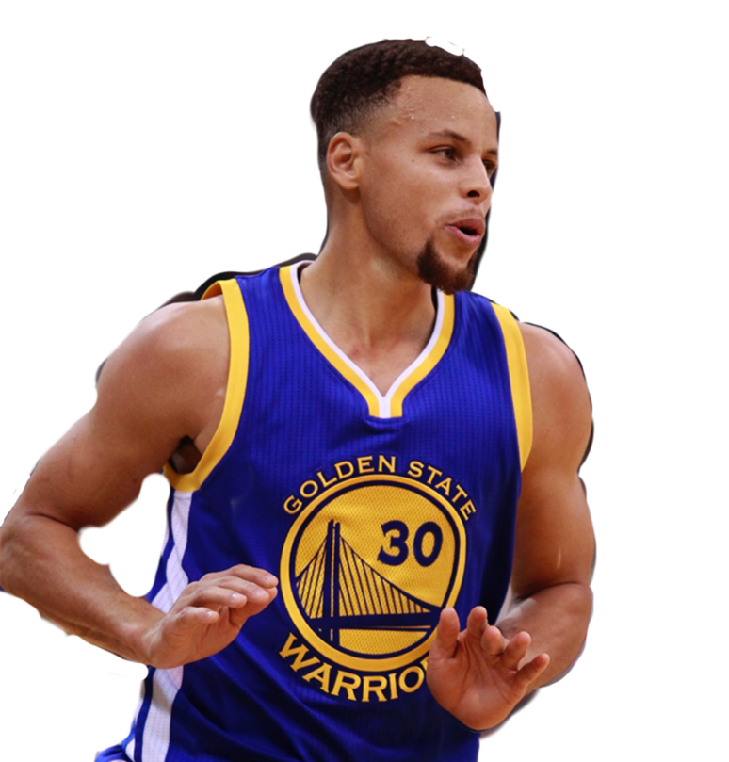
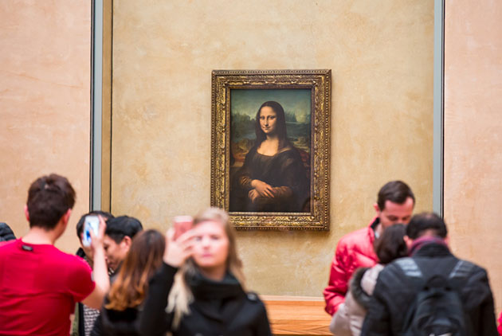
Q4: Was Stephan Curry at the park yesterday?
Ohtani Shohei

Slide 20
No, he wasn’t. He was at the bookstore yesterday.

Slide 21
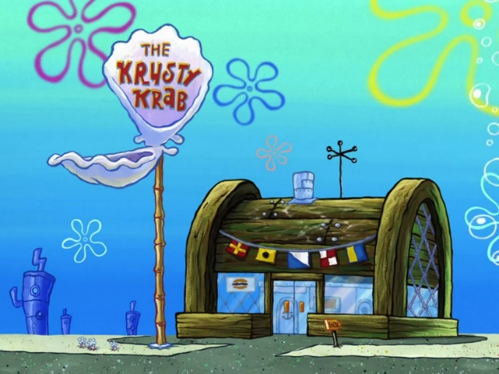
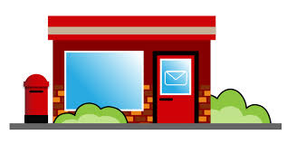
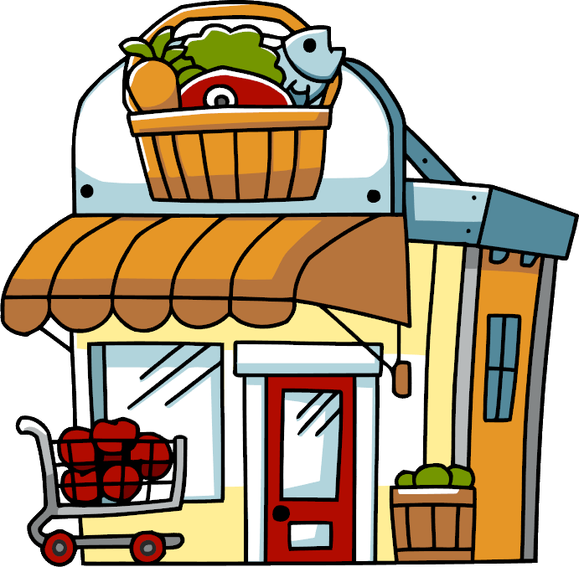
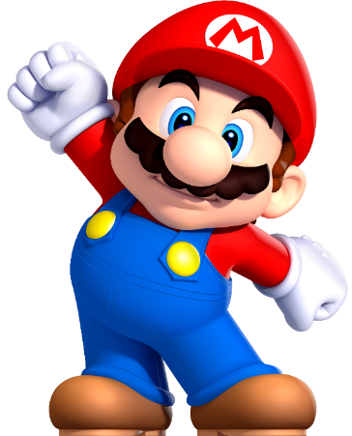
Q5: Was Conan at the restaurant yesterday?

Slide 22
No, he wasn’t. He was at home yesterday.

Slide 23
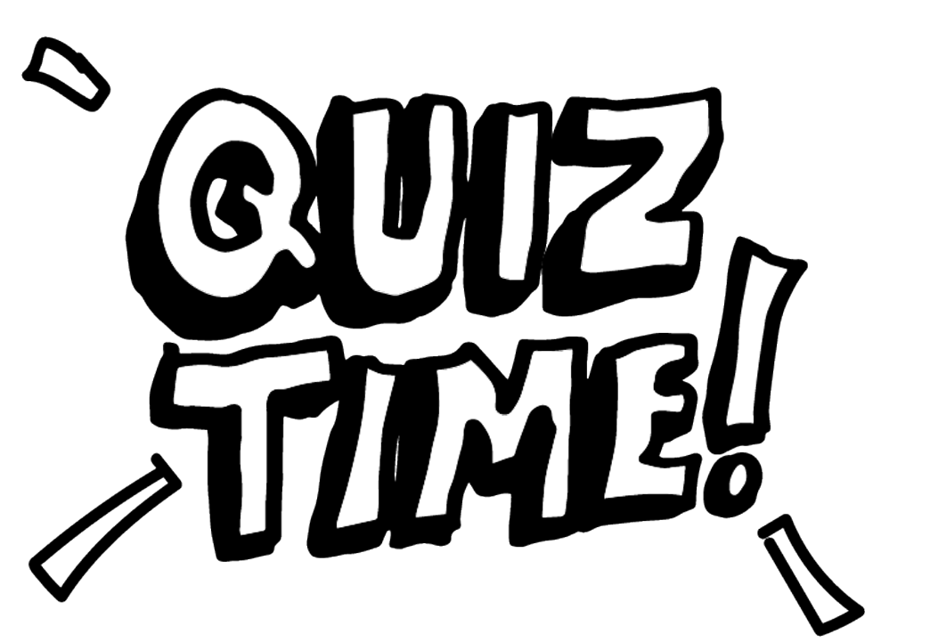
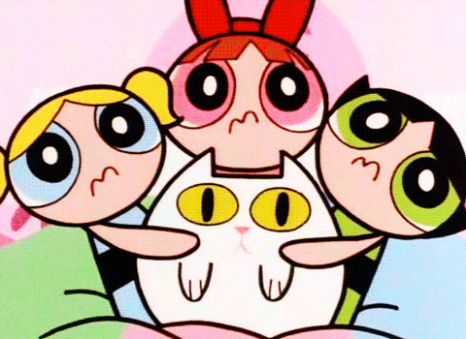
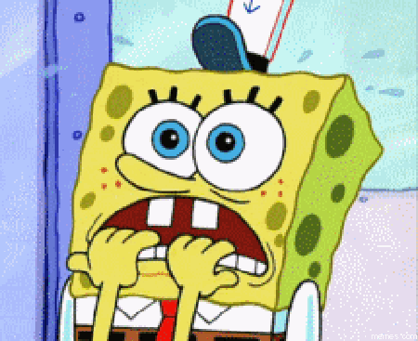

Slide 24
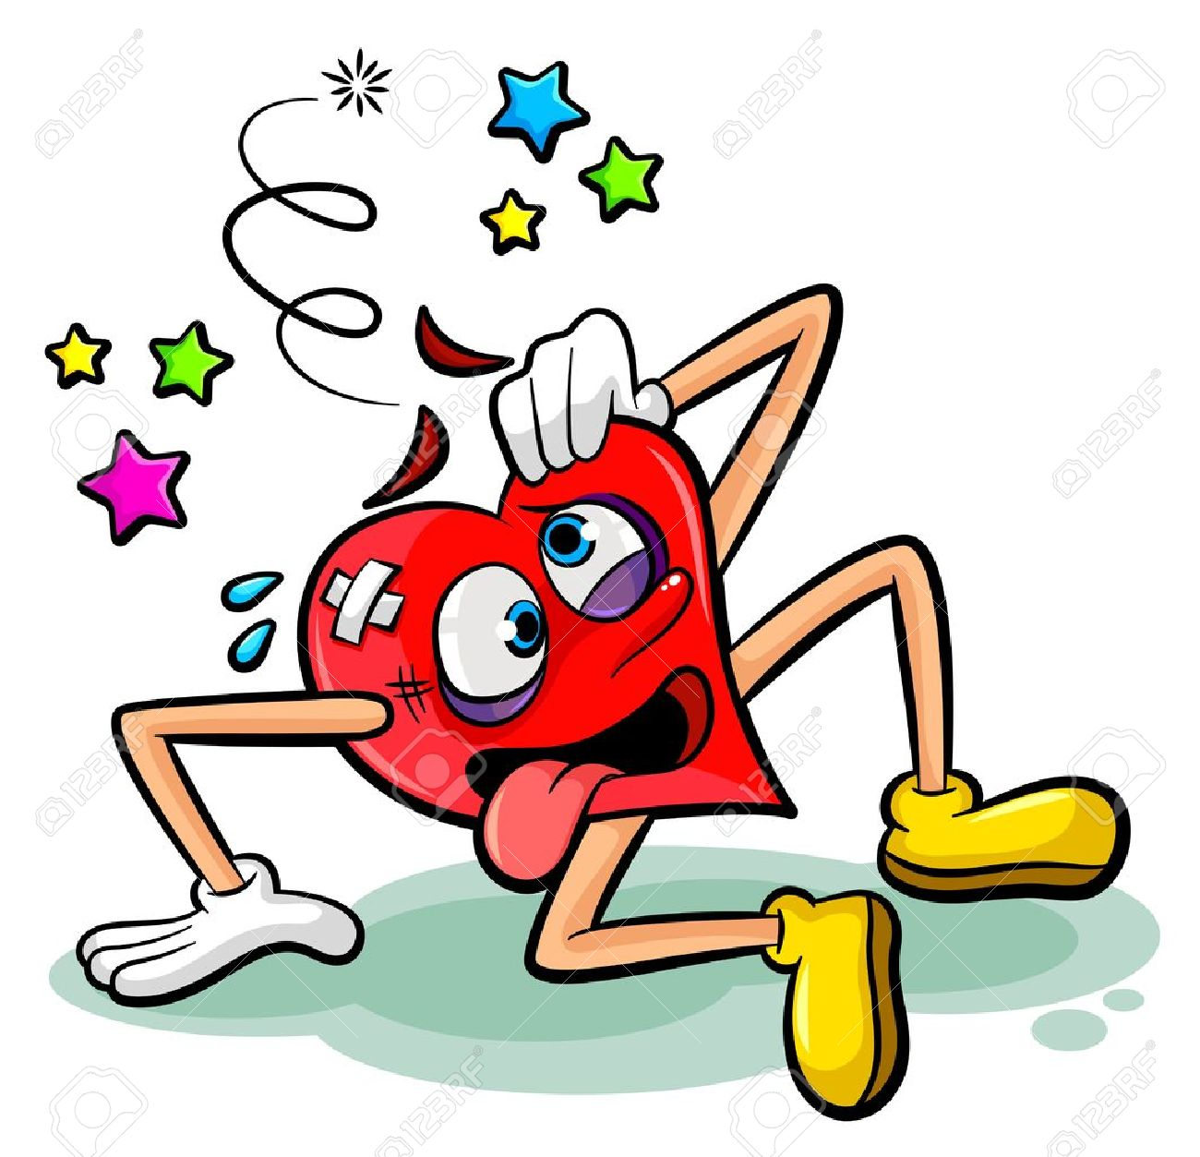
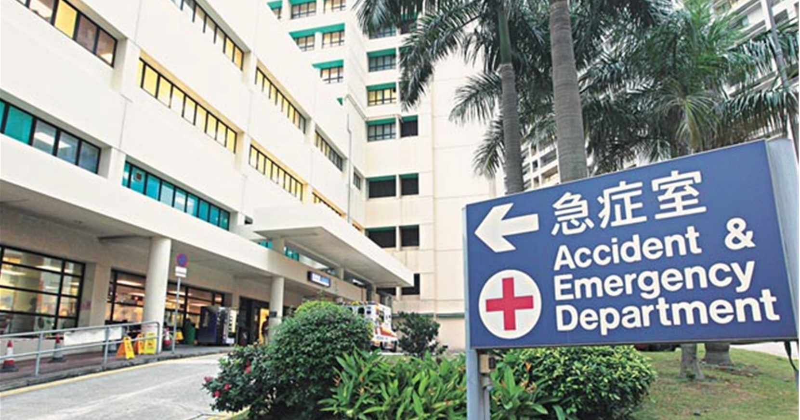
I (was/were) at the __________ yesterday.

Slide 25
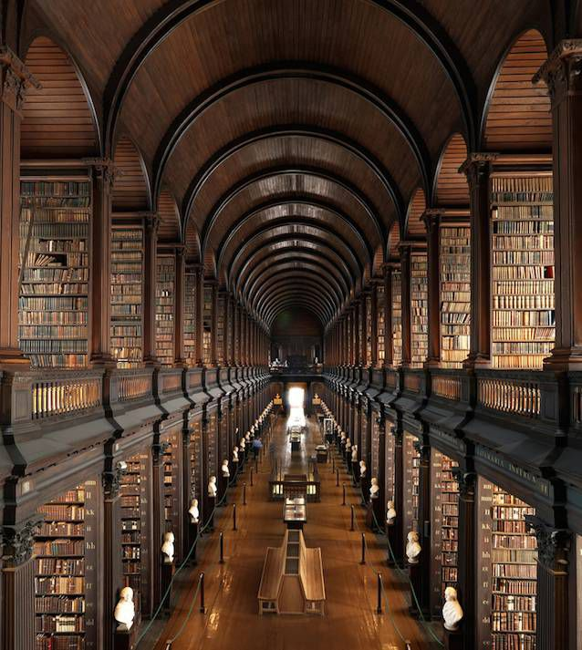
(Was/Were) you at the ________
last year?

Slide 26
He (was/were) at the Korean __________ yesterday afternoon.

Slide 27
(Was/Were) Lady Gaga at the ___________ yesterday morning?

Slide 28
They (was/were) at the ________ and the ________ last night.

Slide 29
(Was/Were) Obama and Trump at the __________ two days ago?

Slide 30
(Was/Were) TWICE and BTS at home last week?
No, they (wasn’t/weren’t).They (was/were) at the _____ last week.

Slide 31
Ash
Mario

Slide 32
at / at the
George
Ash
Mario

